Slide 1

Acid Rain

Slide 2
Introduction to acid rain
Normal rain water is always slightly acidic because CO₂ present in atmosphere. get dissolved in it form carbonic acid. Normal acidity of rain water is 5.6
H₂O (l) + CO₂ (g) H₂CO₃ (aq)
Because of SO₂ & NO₂ gases as pollutants in atmosphere.
The pH of rain is further lowered to as 2.4 & this type of
Precipitation is called as ACID RAIN.
Acid rain is combination of H₂SO₄, HNO₃ and HCl is third

Slide 3
History
Since industrial revolution, emissions of SO₂ & NO₂ in atmosphere have increased.
In 1852 ROBERT ANGUS SMITH was first to show relation b/w acid rain & atmosphere pollution in Manchester (England)
Term acid rain was generated by SMITH in 1972.
Problem of acid rain has not only increased with population & industrial growth but has become widespread.

Slide 4
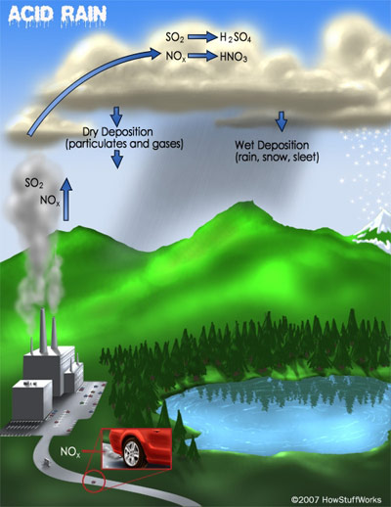
Acid Rain Formation
Emissions of sulfur dioxide and nitrogen oxides react with water vapor in the atmosphere to create sulfuric and nitric acids.

Slide 5
Causes Of Acid Rain
NATURAL CAUSES:-
Volcanic emissions.
Biological processes.
Lightning.
ANTHROPOGENIC CAUSES:-
Factories (industrialization)
Motor vehicles, automobile exhaust.
Coal based power plants.
Domestic fires.
Smelters.

Slide 6
Measurement of acid rain
    Acid rain is measured through pH tests that determine the concentration of hydrogen ions in a liter of fluid. The pH (potential for hydrogen) scale is used to measure acidity or alkalinity. It runs from 0 to 14. (The greater the concentration of hydrogen ions and the lower the pH number, the more acidic a substance is; the lower the concentration of hydrogen ions and the higher the pH number, the more alkaline—or basic—a substance is.) So a pH greater than 7 indicates an alkaline substance while a pH less than 7 indicates an acidic substance

Slide 7
Chemical Processes Involved In acid rain
Formation Of Sulphuric Acid
S + O₂ SO₂
SO₂ + 1/2O₂ + H₂O H₂SO₄
Reaction Involving Formation Of Nitric Acid
NO + O₃ NO₂+O₂
NO₂ + O₃ NO₃+O₂
NO₃ + NO₂ N₂O₅
N₂O₅ + H₂O 2HNO₃

Slide 8

Adverse Effect Of Acid Rain
Plants
Effects plants and trees.
Causes yellowing of leaf tissue (chlorosis).

Slide 9
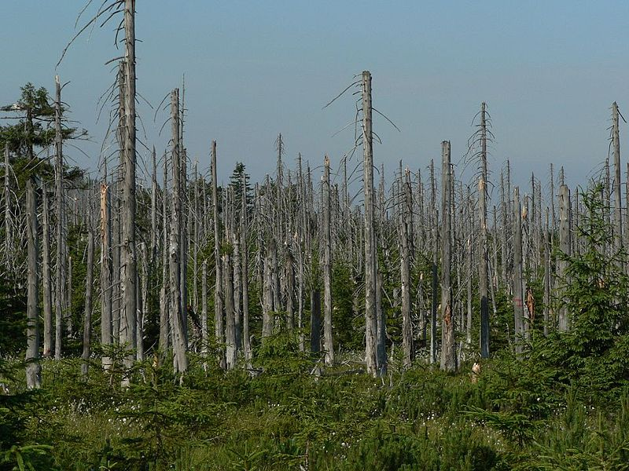
Direct effect on plant growth due to toxification of soil
It takes away soil nutrients causing stunted growth.
Block stomatal pores of leaves.
Electron transport system, biochemical reactions dominated by pH are effected.
Degradation of plant chlorophyll.

Slide 10
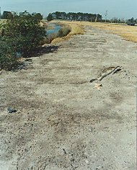
b. Soil
Acid rain damages soil biology and chemistry
Microbes not able to tolerate low pH and die
Upper fertile layer of soil is affect as essential nutrients are leached away from soil

Slide 11
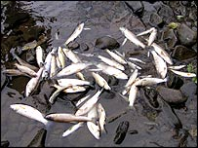
Surface Water And Aquatic Animals
Acid rain causes lower pH & high aluminum conc. in surface water that causes damages to fish and aquatic animals.
Biodiversity of water body is reduced.
Lakes, rivers are fragile ecosystems where each species depend on other to survive ,if one disappears other too disappears.

Slide 12
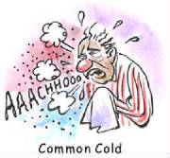
c. Human Health
Aerosol mist of sulfuric acid has very serious respiratory effects.
Acidification play havoc with human nervous system ,respiratory system and digestive system.

Slide 13
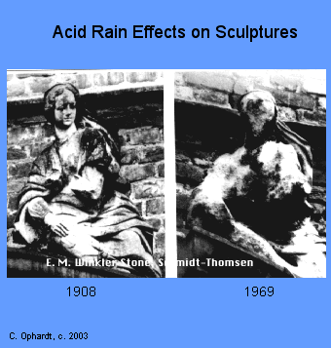
e. Effect On Buildings
Causes extensive damage to buildings, structural materials of marble ,limestone, slate etc.
CaCO₃+H₂SO₄→ CaSO₄+H₂O+CO₂
In Greece and Italy invaluable stone statues have been partially dissolved by acid rain.
Taj Mahal in Agra is also suffering due to acid fumes from Mathura refinery.

Slide 14

Deterioration of Taj Mahal
Taj, the seventh wonder of world getting deteriorated because of emissions of Mathura oil refinery which lies 40 km away from Taj
The oil refinery emits 25-30 tones of SO₂ daily in spite of using low sulphur fuels.

Slide 15
Control measures
Clean combustion technologies
Using pollution control equipments
Replacement of coal by natural gas or renewable energy resources
Liming of lakes and soils
Formulate the policy framework for reduction of sulfur dioxide and other acid rain causing gas emissions.
Support a set of subproject that promote cleaner production, reduce acid rain and air pollution, improve the environment.

Slide 16
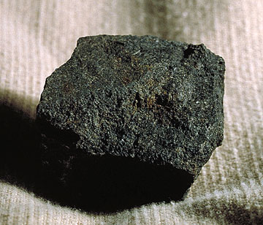
“Soft” (Bituminous) Coal
This is coal that has
a low sulfur content.

Slide 17
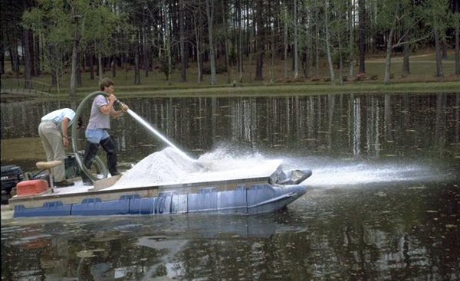
Liming
The process of adding a lime or calcium hydroxide (a base)
to acidified lakes.

Slide 18

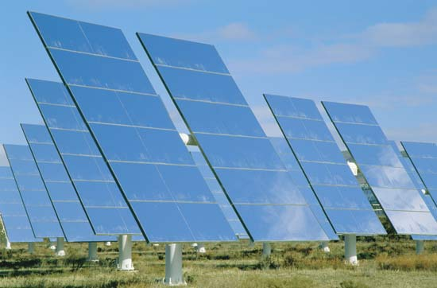
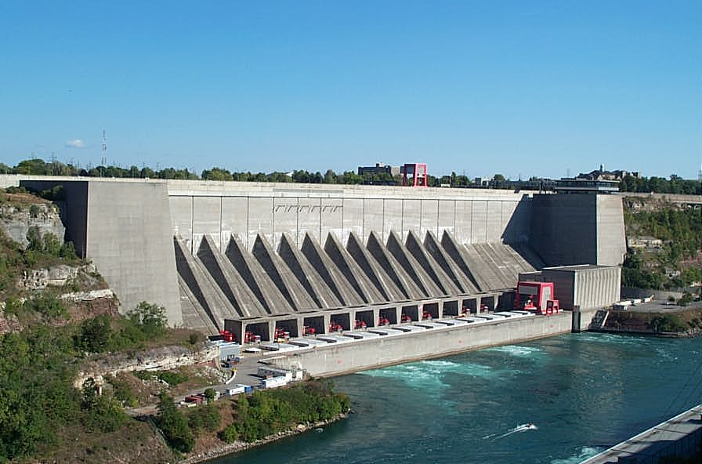
Use Energy Sources that Don’t Produce Nitrogen or Sulfur Oxides

Slide 19
THANK YOU

